Slide 1
COP 4020 – Programming Languages
Smalltalk

Slide 2
Smalltalk overview
Smalltalk was developed by Alan Kay at the Xerox Palo Alto Research Center (PARC) in the early 1970s.
Goal was a total personal computing environment
In 1972, Dan Ingalls developed the first implementation of Smalltalk-72, although Smalltalk-80 is the generally accepted definition of the language.
Smalltalk has several features that make it unique among most languages:
  A total environment design, not just a language
  A minimal language design (comes with a predefined set of class definitions)
  Execution model based on a communication model:
    All data in Smalltalk consists of objects, and methods are considered to be messages sent to objects.

Slide 3
Smalltalk features
Smalltalk attributes:
  1. Each object is an instance of a class.
  2. Each class has a set of associated methods (functions).
  3. Execution proceeds by sending a message (which is one of these methods) to an object of that class.
Historically Smalltalk was the first language to have these features. These features were later borrowed for C++ and Java.

Slide 4
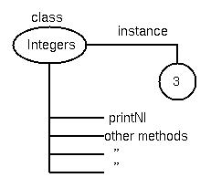
Smalltalk execution
Syntax: object message.
3 printNl. ⇐ Send printNl message to object 3
printNl method prints its argument followed by a new line (Nl).
print method does same except doesn't add a new line.
Note naming convention: thisIsAMethodName
  Words strung together, all except first capitalized.

Slide 5
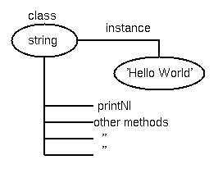
Smalltalk execution (continued)
The printNl method is defined for string objects:
'Hello World' printNl‘. ⇐ Send printNl message to object ‘Hello World’
Each method returns an object, so process can be repeated:
object method1 method2 method3.
Functions are arbitrary so no precedence - left to right evaluation:
2 + 3 * 4 ⇒ 20 (not the expected 14)

Slide 6
Methods
Three kinds of methods:
1. Unary (no parameters)
e.g., myAngle sin
(sends the message “sin” to the myAngle object)
2. Binary (one parameter, an object)
e.g., 12 + 17
(sends the message “+ 17” to the object 12;
the method is “+” and the object parameter is “17”)
3. Keyword (use keywords to organize the parameters)
e.g., myArray at: 1 put: 5
(sends the parameters “1” and “5” to the “at: put:”
method of the object myArray)

Slide 7
More features
Assignments:
  - Simplest Form:
  name1 <- name2 or
  name1 := name2
  - It is simply a pointer assignment
  - RHS can be a message expression
  e.g., index <- index + 1
Other execution features:
- blocks: [ smalltalkStmt. smalltalkStmt]
- ∧ is used to return an object:
∧A returns object A
- send messages to self (own class) or super (parent class of an object)

Slide 8
True and false in Smalltalk
Format:
ifTrue: trueBlock ifFalse: falseBlock
Variables trueBlock and falseBlock are parameters in the body of the method
Example:
(x = 0)
ifTrue:[‘Hello world' printNl]
ifFalse:['Goodbye world' printNl]

Slide 9
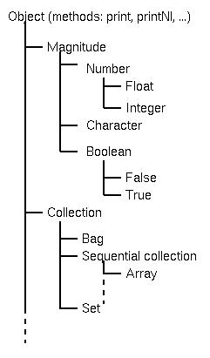
Smalltalk inheritance
Power of Smalltalk is in inheritance
Smalltalk comes with a predefined class library, organized as a hierarchy
All object classes are subclasses of a parent Object class
If any method is not defined for an object, the class hierarchy is traversed upwards until a parent of that object is found with the same method
Earlier example:
    3 printNl.
    ‘Hello’ printNl.
  printNl is a method defined in Object class

Slide 10
Creating classes and methods
Two types of methods:
  Class methods - Applies to class objects (Integer)
  Class instance methods - Applies to instances of a class (2, 3, 42)
Create a new class – Send the following 5-keyword method to the Object class to create a new subclass:
  Object subclass: #newClassName
  instanceVariableNames: instanceVariables “local data”
  classVariableNames: classVariables “class data”
  poolDictionaries: ‘ ’ “global variable references”
  category: name. “used to organize class library”

Slide 11
Creating classes (continued)
Example:
A SignedInteger class which is a subclass of Integer:
Integer subclass: #SignedInteger
instanceVariableNames: ‘value sign’
classVariableNames: ‘ ’
poolDictionaries: ‘ ’
category: Integers.
# gives the name of a global attribute (symbol)

Slide 12
Smalltalk – language summary
Smalltalk is a pure OOP language:
- Everything is an object
- All computation is through objects sending messages to objects
- It adopts none of the appearance of imperative languages
The Smalltalk environment
- The first complete GUI system
- A complete environment for software development
- All of the system source code is available for programmers to view and modify!

Slide 13
Smalltalk – some OO features
Type Checking and Polymorphism:
- All bindings of messages to methods are dynamic
- The process is to search the object to which the message is sent for the method; if not found, search the superclass, etc.
- Because all variables are typeless, all methods are polymorphic
Inheritance:
- All subclasses are subtypes of the Object class
- Methods can be redefined, but can’t be hidden
- Variables hidden unless they have accessor/mutator methods defined
- No multiple inheritance

